Slide 1
Putting PowerPoint To Use
Dave Campbell

Slide 2
Scope
Learning PowerPoint basics.
Learning Ways to Effectively Use PowerPoint
Presentations.
Task Documentation.
Posters, banners, flyers, …
Presentation nomenclature…
[File|Save As] used to indicate hierarchical menu selections.
ALT-Tab: Bold used to indicate Microsoft or other terminology.

Slide 3
PowerPoint
PowerPoint is MicroSoft’s presentation tool.
It can be used to make very impressive professional presentations.
PowerPoint supports a number of powerful features including animation.
PowerPoint is MicroSoft proprietary, but does provide a number of ways of exporting content, including SaveAs a PDF.
Open Office Impress and Google Sheets provide alternatives.

Slide 4
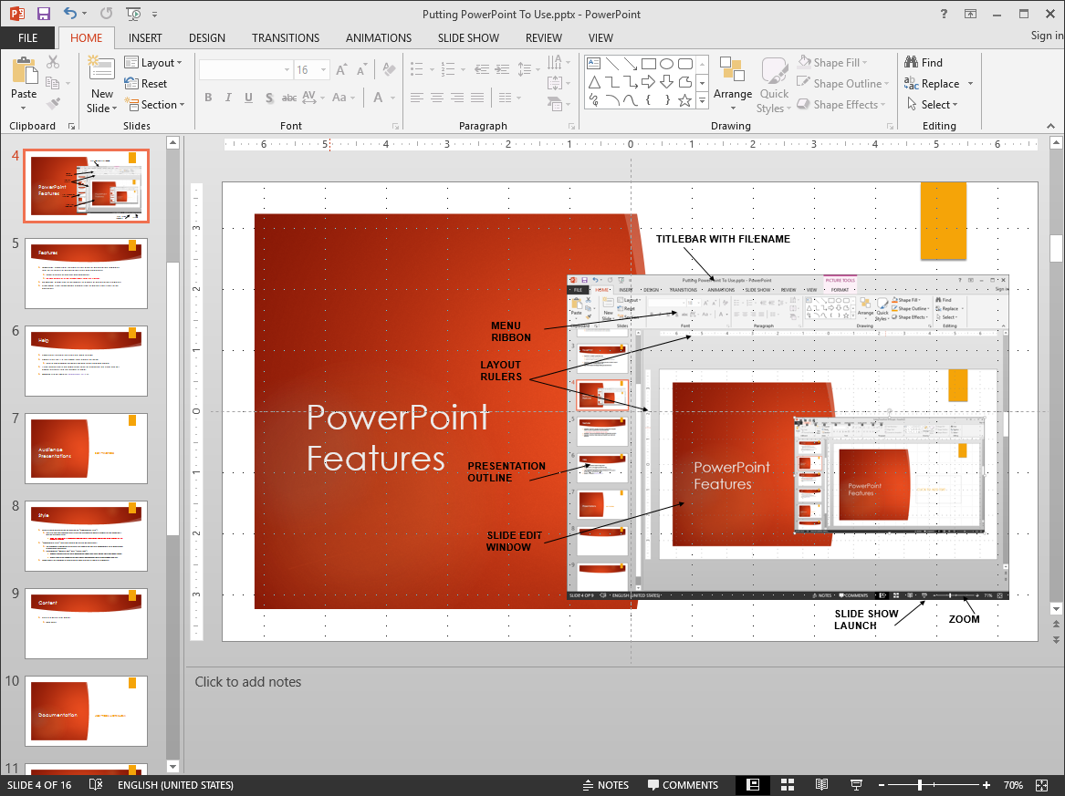
PowerPoint Features
TITLEBAR WITH FILENAME
MENU RIBBON
LAYOUT RULERS
CENTER GUIDES
PRESENTATION OUTLINE
SLIDE EDIT WINDOW
PRESENTER’S NOTES
SLIDE SHOW LAUNCH
ZOOM

Slide 5
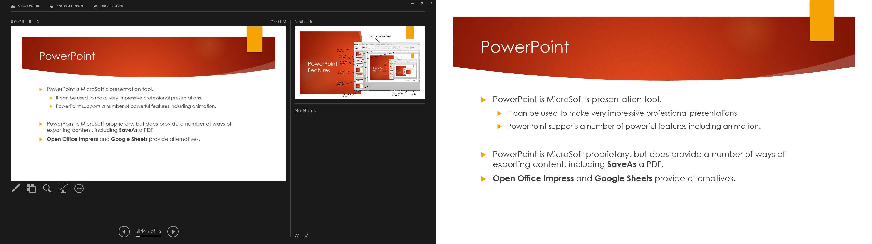
Slide Show Mode – Dual Display
NEXT SLIDE
PRESENTERS WINDOW
DISPLAY #1
PRESENTERS NOTES
SHOW WINDOW
DISPLAY #2
CURRENT SLIDE
DISPLAYS FULL SCREEN WITHOUT GUIDES, RULERS, ETC.
Exercise: Play with the PowerPoint window and Slide Show mode. In Show mode, play with the various options buttons.
SHOW OPTIONS
PREVIOUS/NEXT SLIDE ADVANCE BUTTONS

Slide 6
Features
Templates: PowerPoint includes a vast array of presentation templates that suit a variety of presentation styles and audiences.
Target a variety of end uses and audiences.
Be very careful of using spreadsheets from the Internet.
WYSIWYG: What You See Is What You Get formatting.
Powerful graphics and presentation methods.
Animation: Allows you to automate to display of presentation elements.
Slide Show: Built-in Slide Show mode enables you to present your slides to an audience.

Slide 7
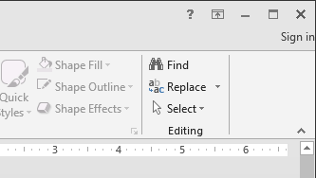
Help
PowerPoint includes an excellent Help system.
Simply click the ? In the upper right corner for Help.
Enter a few keywords for which you wish to get help and search.
If you inadvertently do something, such as changing the view, you will almost certainly find the answer in Help.
Google It! – Be specific PowerPoint 2013 …

Slide 8
Audience Presentations
Best Practices
Exercise:
Pick a topic
Create a New blank PowerPoint presentation.
Title it and Save

Slide 9
Style
Begin a New presentation by picking an “appropriate style”
See Best Practices.
The style can be changed later, either by customizing specific aspects or by replacing it with an alternate style.
NOTE: This may result in undesirable reformatting of slide content forcing you to edit content to fit or appear as desired.
“Appropriate Style” decision should be driven by audience.
For example, a whimsical or childish style would not be very appropriate for a professional or workforce audience.
Recommend “modern look” over “classic look”.
Modern characterized by lighter background, simpler and lighter weight fonts, and bolder colors.
Classic tend to use typewriter-like fonts, darker backgrounds, and less white-space and flair.
Sometimes the template may be dictated, for example, for a conference.
Exercise: Select a style for your presentation.

Slide 10
Appropriate Style – Best Practices
I recommend using internal PowerPoint templates.
Consider the presentation arena – distance to audience, lighting, etc.
Can they see what your presenting, can they read it?
Recommend 18 pt minimum for large audience.
Do you need to provide hardcopies – does the presentation print well?
Use ALL caps ONLY for word emphasis or captions – NOT general text.
ALL CAPS SIGNIFIES SHOUTING!
Consider bold or font color change alternatives.
Stick to 3-4 font styles per slide and per presentation, including colors, bold, and italics – more only if designating key words, external references, etc.

Slide 11
Slide Layout
Most presentations use a basic title and content layout (i.e. this slide form).
PowerPoint templates usually provide a set of different slide layouts, such as two column, title only, blank, and topic headings.
Right-click on the slide edge (i.e. to not select anything) and select layout to see the variants included in the specific template or change the particular layout.
NOTE: Older PC displays used a 4:3 width to height ratio; HD displays use a 16:9. The presentation system will “force fit” to the display, which may create undesirable layout effects, and should be considered when defining slide layout.
Exercise: Add a couple slides and change the layout.

Slide 12
Content
Address the intent of the presentation – don’t wonder off topic.
Brevity – bullets not prose.
Add notes to the presenters window if you need more details to remember.
Stick to the flow.
Target 3 points +/- per topic.
Use hierarchy for priority.
Main points as top level.
Less significant details as sub-bullets. (Press TAB to indent.)
Clarification and notes at lower level.
Exercise: Play with adding bullets, indenting, etc. Add too many bullets and observe what happens.

Slide 13


Best Supporting Content
PowerPoint is for visual presentations.
Less words.
More graphics.
More whitespace.
Drawing and highlighting too!
Sidebars or footnote textboxes should follow a consistent style.
Exercise: Insert some graphics. Draw something.

Slide 14
Outline Slides
With PowerPoint you can include slides of different layout designed specifically for organizing your presentation outline such as section heading and title and caption slides.
Include a title slide – used to create thumbnail.
It is also common to include a list of covered topics at the beginning of the presentation. If you do this, …
DO NOT PRESENT IT! That is, don’t talk about it. The audience can read and digest a list far faster than your presentation of it.
Commonly, presenters end up telling the audience everything in the rest of the talk from just the list, and then bore the audience by presenting it again.
I prefer the use of a SCOPE slide that forces me to succinctly say what the presentation covers, which helps me keep on topic as well.
Exercise: Add an outline or scope slide to the beginning of your presentation.

Slide 15
Timing
Determine your presentation speed.
Recommend 2-3 minutes per slide.
If you are faster, you might want to slow your speed as viewers may not keep up.
If you are slower, you are likely presenting too much minutia, on talking too slow.
Less time for “outline” slides.
Recommend using outline slides for organization only and skipping during presentation.
Stick to slides while presenting.
Take detailed discussion off-line.
Over estimate time!
Audiences grow tired and lose interest in long-winded, run-over presentations.

Slide 16
Slide Show Mode
PowerPoint 2013 provides new show features including a preview of the next slide to prompt your memory.
You can turn on a mouse driven “laser pointer” that works with TVs!
TRANSITIONS Menu provides many features for changing slides, including appearance and self-timed action.
Press…
Page Up or Page Down or up/down or left/right arrow keys to advance show.
ESC to end a show; F5 to start over; Shift-F5 to restart where you left off.
CTRL-G followed by a page number to jump to that page.
TIP: COMMIT LISTED KEY ACTIONS TO MEMORY TO SAVE YOURSELF THE EMBARRASSMENT.
Exercise: Play with your presentation in slide show mode. Start, stop, and restart it.

Slide 17
Presenting
What you learned in speech class still applies.
DO NOT READ THE SLIDES! – audience can do that faster than you.
Talk about the slides and add detail (from your notes).
Use slides, such as section heading slides, to prompt you to include stories, discussion, and other content that you don’t explicitly state.
Take questions during presentation…
SO your don’t lose your audience.
BUT limit responses.
If you can’t quickly answer it and stay on track timing-wise, table it until the end.

Slide 18
Backup Content
Common to include backup content at end of presentation.
Keeps clutter out of main presentation.
Provide details for things you may anticipate the audience may want to know more about, if time allows.
And, I often go back and add addendums to original presentations for clarification or as information evolves or changes.
Placing new content in an addendum means original presentation remains unchanged for record purposes.
Exercise: Create a backup section. Add a backup slide.

Slide 19
Documentation
Less Prose, More Show

Slide 20
Documentation Uses
PowerPoint provides a very effective means of documenting a variety of things besides just creating audience presentations.
Best when documentation involves less prose and more illustration.
MS Word better for lengthy prose discussion.
Some documentation examples include…
Describing a topic from a learning or tutorial perspective.
Providing (ordered) step-by-step instructions.
Documenting a workflow, design derivation, or process.
Visual instructions.
Keeping records of an ongoing activity or logging actions.

Slide 21
Documentation Presentation Design
Contrary to typical audience presentations, a PowerPoint for documentation should include DETAIL.
Since you are documenting a process, activity, instructions, or such, you include every piece of information any user may need.
More sophisticated users can skip unneeded content, but the presentation should not leave out details that a less skilled user may find helpful.
Prioritize information delivery.
Typically one main point per slide. (Power User friendly.)
Many sub-bullet details. (Casual user friendly.)
Extra details in note boxes or sub-sbu-bullets.

Slide 22
Details
Add details, but not wordiness!
If it takes a lot of words, then it’s prose, so use Word.
Add graphics as possible to illustrate operations, actions, picture parts, …
For computer operations include pictures of the dialogs, etc.
For equations, accounting, and other numbers work, show derivation.
Addendums for changes also useful for documentation of changes.
You may want to mark some information as obsolete without deleting or changing it as record of origination.

Slide 23
Other Applications and Topics
I Can Do That!

Slide 24
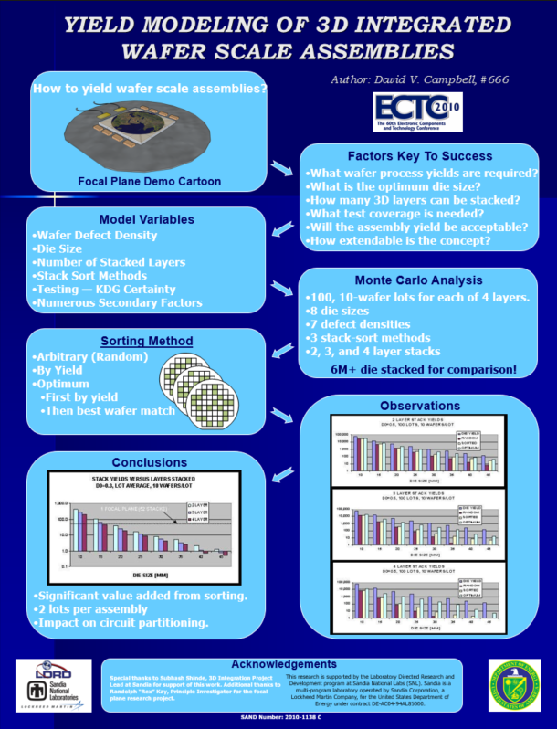
Posters and Banners
PowerPoint allows you to create any size slide, which means you can easily create large poster presentations, as well as banners.
Many services exist that will “print” your poster on a variety of materials.
The poster at the right fits an “E” size sheet (36”x46”) printed on “Velcro” backed plastic sheet for direct attach to a standard felt covered conference display board.

Slide 25
Labels, Business Cards, Lists, …
Many other possibilities ranging from …
Labels to Business Cards.
Birthday cards and Invitations.
Manuals.
Logs – timeline record.

Slide 26

Animation
You can animate slide content.
Limit use in professional work.
Too much bores the audience, especially if they think you put more effort into the animation than thinking about content.
Many ways to animate, including appearance, timing, grouping, ordering, and visual effects.
Good for “feeding” related content to audience, step-by-step.
Again, don’t over do it!
Exercise: Animate one of your slides.

Slide 27
Slide Sorting
[View | Slide Sorter]
Lets you see all your slides and drag them into a new order.
Can also be done in outline view, but probably can’ see all slides.

Slide 28
Slide Master View
[View | Slide Master]
Used to create or customize your template.
Define default font characteristics, slide layouts, etc.
Changes effect all slides at once.
Slide background only editable in Slide Master View.

Slide 29
INSERT Menu
Tables, pictures, charts, text boxes, Word Art, equations, symbols…
BUT also embedded video, audio, functioning hyperlinks, …
Header and Footer
Automatic time, date, and page number, …
I recommend always including slide numbers so the audience can reference them.
Hyperlinks, videos, other presentations – can be active from presentation slide show – test in advance!

Slide 30
REVIEW Menu
Microsoft Track Changes and reviewer Comments supported.
Spell checking.
No excuse for misspellings in presentations – reflect poor quality of organization.
Thesaurus.

